Slide 1
SOA Exam FM
Module 3 – Section 2
Outstanding Balance (with Drop Payment)

Slide 2

$$Outstanding Balance Example$$
A loan of 100,000 at a monthly effective interest rate of 0.5% is repaid with regular monthly payments of 1000 and a final smaller payment one month after the last regular payment. Determine the outstanding balance immediately after the 50th regular payment.

Slide 3
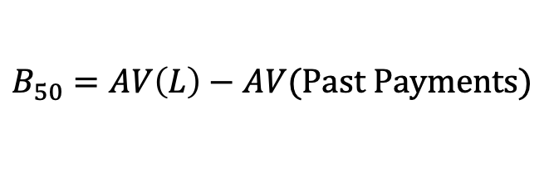
$$Outstanding Balance Example$$
A loan of 100,000 at a monthly effective interest rate of 0.5% is repaid with regular monthly payments of 1000 and a final smaller payment one month after the last regular payment. Determine the outstanding balance immediately after the 50th regular payment.
$$B_{50}=AV\left(L\right)−AV(Past Payments)$$
$$Retro$$

Slide 4
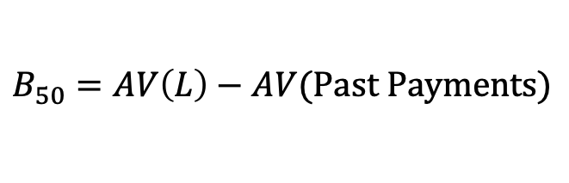
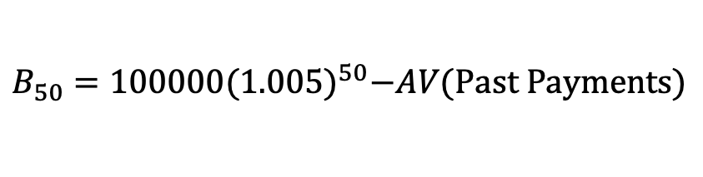
$$Outstanding Balance Example$$
A loan of 100,000 at a monthly effective interest rate of 0.5% is repaid with regular monthly payments of 1000 and a final smaller payment one month after the last regular payment. Determine the outstanding balance immediately after the 50th regular payment.
$$B_{50}=AV\left(L\right)−AV(Past Payments)$$
$$Retro$$
$$B_{50}=100000{(1.005)}^{50}−AV(Past Payments)$$

Slide 5
$$Outstanding Balance Example$$
A loan of 100,000 at a monthly effective interest rate of 0.5% is repaid with regular monthly payments of 1000 and a final smaller payment one month after the last regular payment. Determine the outstanding balance immediately after the 50th regular payment.
$$B_{50}=AV\left(L\right)−AV(Past Payments)$$
$$Retro$$
$$B_{50}=100000{(1.005)}^{50}−1000s_{\overline{50}|0.005}$$

Slide 6
$$Outstanding Balance Example$$
A loan of 100,000 at a monthly effective interest rate of 0.5% is repaid with regular monthly payments of 1000 and a final smaller payment one month after the last regular payment. Determine the outstanding balance immediately after the 50th regular payment.
$$B_{50}=AV\left(L\right)−AV(Past Payments)$$
$$Retro$$
$$B_{50}=100000{(1.005)}^{50}−1000s_{\overline{50}|0.005}$$
$$100000{(1.005)}^{50}−1000s_{\overline{50}|0.005}−B_{50}=0$$

Slide 7
$$Outstanding Balance Example$$
A loan of 100,000 at a monthly effective interest rate of 0.5% is repaid with regular monthly payments of 1000 and a final smaller payment one month after the last regular payment. Determine the outstanding balance immediately after the 50th regular payment.
$$B_{50}=AV\left(L\right)−AV(Past Payments)$$
$$Retro$$
$$B_{50}=100000{(1.005)}^{50}−1000s_{\overline{50}|0.005}$$
$$100000{(1.005)}^{50}−1000s_{\overline{50}|0.005}−B_{50}=0$$
TVM:
END
50
N
0.5
I/Y
100000
PV
1000
+/-
PMT
CPT
FV

Slide 8

$$Outstanding Balance Example$$
A loan of 100,000 at a monthly effective interest rate of 0.5% is repaid with regular monthly payments of 1000 and a final smaller payment one month after the last regular payment. Determine the outstanding balance immediately after the 50th regular payment.
$$B_{50}=AV\left(L\right)−AV(Past Payments)$$
$$Retro$$
$$B_{50}=100000{(1.005)}^{50}−1000s_{\overline{50}|0.005}$$
$$100000{(1.005)}^{50}−1000s_{\overline{50}|0.005}−B_{50}=0$$
TVM:
END
50
N
0.5
I/Y
100000
PV
1000
+/-
PMT
CPT
FV
$$B_{50}=71,677.42$$

Slide 9
$$Outstanding Balance Example$$
A loan of 100,000 at a monthly effective interest rate of 0.5% is repaid with regular monthly payments of 1000 and a final smaller payment one month after the last regular payment. Determine the outstanding balance immediately after the 50th regular payment.

Slide 10
$$Outstanding Balance Example$$
A loan of 100,000 at a monthly effective interest rate of 0.5% is repaid with regular monthly payments of 1000 and a final smaller payment one month after the last regular payment. Determine the outstanding balance immediately after the 50th regular payment.

Slide 11

$$Drop Payment Example$$
A loan of 100,000 at a monthly effective interest rate of 0.5% is repaid with regular monthly payments of 1000 and a final smaller payment one month after the last regular payment. Determine the outstanding balance immediately after the 50th regular payment. Determine the amount of the drop payment.

Slide 12
$$Drop Payment Example$$
A loan of 100,000 at a monthly effective interest rate of 0.5% is repaid with regular monthly payments of 1000 and a final smaller payment one month after the last regular payment. Determine the outstanding balance immediately after the 50th regular payment. Determine the amount of the drop payment.

Slide 13

$$Drop Payment Example$$
A loan of 100,000 at a monthly effective interest rate of 0.5% is repaid with regular monthly payments of 1000 and a final smaller payment one month after the last regular payment. Determine the outstanding balance immediately after the 50th regular payment. Determine the amount of the drop payment.
$$100000=1000a_{\overline{n|}0.005}$$

Slide 14

$$Drop Payment Example$$
A loan of 100,000 at a monthly effective interest rate of 0.5% is repaid with regular monthly payments of 1000 and a final smaller payment one month after the last regular payment. Determine the outstanding balance immediately after the 50th regular payment. Determine the amount of the drop payment.
$$100000=1000a_{\overline{n|}0.005}$$
$$⇒n=138+$$

Slide 15








$$Drop Payment Example$$
A loan of 100,000 at a monthly effective interest rate of 0.5% is repaid with regular monthly payments of 1000 and a final smaller payment one month after the last regular payment. Determine the outstanding balance immediately after the 50th regular payment. Determine the amount of the drop payment.
$$1000$$
$$1000$$
$$⋯$$
$$1000$$
$$Y$$
$$⋯$$
$$1$$
$$2$$
$$138$$
$$139$$
$$L=100000$$

Slide 16

$$Drop Payment Example$$
A loan of 100,000 at a monthly effective interest rate of 0.5% is repaid with regular monthly payments of 1000 and a final smaller payment one month after the last regular payment. Determine the outstanding balance immediately after the 50th regular payment. Determine the amount of the drop payment.
$$1000$$
$$1000$$
$$⋯$$
$$1000$$
$$Y$$
$$⋯$$
$$1$$
$$2$$
$$138$$
$$139$$
$$L=100000$$

Slide 17

$$Drop Payment Example$$
A loan of 100,000 at a monthly effective interest rate of 0.5% is repaid with regular monthly payments of 1000 and a final smaller payment one month after the last regular payment. Determine the outstanding balance immediately after the 50th regular payment. Determine the amount of the drop payment.
$$1000$$
$$1000$$
$$⋯$$
$$1000$$
$$Y$$
$$⋯$$
$$1$$
$$2$$
$$138$$
$$139$$
$$L=100000$$
$$B_{138}$$

Slide 18

$$Drop Payment Example$$
A loan of 100,000 at a monthly effective interest rate of 0.5% is repaid with regular monthly payments of 1000 and a final smaller payment one month after the last regular payment. Determine the outstanding balance immediately after the 50th regular payment. Determine the amount of the drop payment.
$$1000$$
$$1000$$
$$⋯$$
$$1000$$
$$Y$$
$$⋯$$
$$1$$
$$2$$
$$138$$
$$139$$
$$L=100000$$
$$B_{138}$$
$$Y=B_{138}∙(1.005)$$

Slide 19
$$Drop Payment Example$$
A loan of 100,000 at a monthly effective interest rate of 0.5% is repaid with regular monthly payments of 1000 and a final smaller payment one month after the last regular payment. Determine the outstanding balance immediately after the 50th regular payment. Determine the amount of the drop payment.
$$1000$$
$$1000$$
$$⋯$$
$$1000$$
$$Y$$
$$⋯$$
$$1$$
$$2$$
$$138$$
$$139$$
$$L=100000$$
$$B_{138}$$
$$Retro$$
$$B_{138}=100000{(1.005)}^{138}−1000s_{\overline{138}|0.005}$$

Slide 20

$$Drop Payment Example$$
A loan of 100,000 at a monthly effective interest rate of 0.5% is repaid with regular monthly payments of 1000 and a final smaller payment one month after the last regular payment. Determine the outstanding balance immediately after the 50th regular payment. Determine the amount of the drop payment.
$$1000$$
$$1000$$
$$⋯$$
$$1000$$
$$Y$$
$$⋯$$
$$1$$
$$2$$
$$138$$
$$139$$
$$L=100000$$
$$B_{138}$$
$$=970.93$$
$$Retro$$
$$B_{138}=100000{(1.005)}^{138}−1000s_{\overline{138}|0.005}$$

Slide 21

$$Drop Payment Example$$
A loan of 100,000 at a monthly effective interest rate of 0.5% is repaid with regular monthly payments of 1000 and a final smaller payment one month after the last regular payment. Determine the outstanding balance immediately after the 50th regular payment. Determine the amount of the drop payment.
$$1000$$
$$1000$$
$$⋯$$
$$1000$$
$$Y$$
$$⋯$$
$$1$$
$$2$$
$$138$$
$$139$$
$$L=100000$$
$$B_{138}$$
$$=970.93$$
$$Y=970.93∙(1.005)$$

Slide 22

$$Drop Payment Example$$
A loan of 100,000 at a monthly effective interest rate of 0.5% is repaid with regular monthly payments of 1000 and a final smaller payment one month after the last regular payment. Determine the outstanding balance immediately after the 50th regular payment. Determine the amount of the drop payment.
$$1000$$
$$1000$$
$$⋯$$
$$1000$$
$$Y$$
$$⋯$$
$$1$$
$$2$$
$$138$$
$$139$$
$$L=100000$$
$$B_{138}$$
$$=970.93$$
$$Y=970.93∙(1.005)$$
$$=975.78$$

Slide 23


$$Drop Payment Example$$
A loan of 100,000 at a monthly effective interest rate of 0.5% is repaid with regular monthly payments of 1000 and a final smaller payment one month after the last regular payment. Determine the outstanding balance immediately after the 50th regular payment. Determine the amount of the drop payment.
$$1000$$
$$1000$$
$$⋯$$
$$1000$$
$$975.78$$
$$⋯$$
$$1$$
$$2$$
$$138$$
$$139$$
$$L=100000$$

Slide 24
$$Outstanding Balance Example$$
A loan of 100,000 at a monthly effective interest rate of 0.5% is repaid with regular monthly payments of 1000 and a final smaller payment one month after the last regular payment. Determine the outstanding balance immediately after the 50th regular payment. Determine the amount of the drop payment.
$$1000$$
$$1000$$
$$⋯$$
$$1000$$
$$975.78$$
$$⋯$$
$$1$$
$$2$$
$$138$$
$$139$$
$$L=100000$$

Slide 25
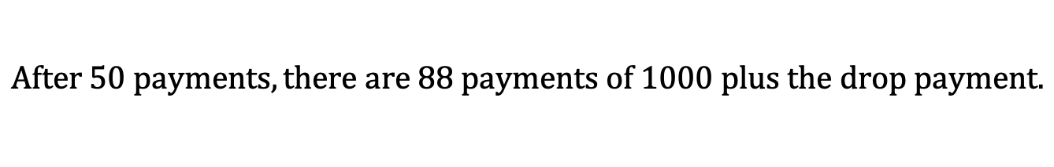
$$Outstanding Balance Example$$
A loan of 100,000 at a monthly effective interest rate of 0.5% is repaid with regular monthly payments of 1000 and a final smaller payment one month after the last regular payment. Determine the outstanding balance immediately after the 50th regular payment. Determine the amount of the drop payment.
$$1000$$
$$1000$$
$$⋯$$
$$1000$$
$$975.78$$
$$⋯$$
$$1$$
$$2$$
$$138$$
$$139$$
$$L=100000$$
$$After 50 payments, there are 88 payments of 1000 plus the drop payment.$$

Slide 26


$$Outstanding Balance Example$$
A loan of 100,000 at a monthly effective interest rate of 0.5% is repaid with regular monthly payments of 1000 and a final smaller payment one month after the last regular payment. Determine the outstanding balance immediately after the 50th regular payment. Determine the amount of the drop payment.
$$1000$$
$$1000$$
$$⋯$$
$$1000$$
$$975.78$$
$$⋯$$
$$1$$
$$2$$
$$138$$
$$139$$
$$L=100000$$
$$After 50 payments, there are 88 payments of 1000 plus the drop payment.$$
$$Pro$$
$$PV(Remaining Payments)$$
$$B_{50}=$$

Slide 27

$$Outstanding Balance Example$$
A loan of 100,000 at a monthly effective interest rate of 0.5% is repaid with regular monthly payments of 1000 and a final smaller payment one month after the last regular payment. Determine the outstanding balance immediately after the 50th regular payment. Determine the amount of the drop payment.
$$1000$$
$$1000$$
$$⋯$$
$$1000$$
$$975.78$$
$$⋯$$
$$1$$
$$2$$
$$138$$
$$139$$
$$L=100000$$
$$After 50 payments, there are 88 payments of 1000 plus the drop payment.$$
$$Pro$$
$$B_{50}=$$
$$1000a_{\overline{88}|0.005}+975.78v^{89}$$

Slide 28

$$Outstanding Balance Example$$
A loan of 100,000 at a monthly effective interest rate of 0.5% is repaid with regular monthly payments of 1000 and a final smaller payment one month after the last regular payment. Determine the outstanding balance immediately after the 50th regular payment. Determine the amount of the drop payment.
$$1000$$
$$1000$$
$$⋯$$
$$1000$$
$$975.78$$
$$⋯$$
$$1$$
$$2$$
$$138$$
$$139$$
$$L=100000$$
$$After 50 payments, there are 88 payments of 1000 plus the drop payment.$$
$$Pro$$
$$B_{50}=$$
$$1000a_{\overline{88}|0.005}+(975.78v)v^{88}$$

Slide 29
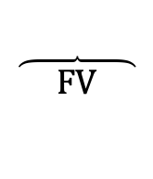
$$Outstanding Balance Example$$
A loan of 100,000 at a monthly effective interest rate of 0.5% is repaid with regular monthly payments of 1000 and a final smaller payment one month after the last regular payment. Determine the outstanding balance immediately after the 50th regular payment. Determine the amount of the drop payment.
$$1000$$
$$1000$$
$$⋯$$
$$1000$$
$$975.78$$
$$⋯$$
$$1$$
$$2$$
$$138$$
$$139$$
$$L=100000$$
$$After 50 payments, there are 88 payments of 1000 plus the drop payment.$$
$$Pro$$
$$B_{50}=$$
$$1000a_{\overline{88}|0.005}+(975.78v)v^{88}$$
$$\overbrace{ FV }$$

Slide 30

$$Outstanding Balance Example$$
A loan of 100,000 at a monthly effective interest rate of 0.5% is repaid with regular monthly payments of 1000 and a final smaller payment one month after the last regular payment. Determine the outstanding balance immediately after the 50th regular payment. Determine the amount of the drop payment.
$$1000$$
$$1000$$
$$⋯$$
$$1000$$
$$975.78$$
$$⋯$$
$$1$$
$$2$$
$$138$$
$$139$$
$$L=100000$$
$$After 50 payments, there are 88 payments of 1000 plus the drop payment.$$
$$Pro$$
$$B_{50}=$$
$$1000a_{\overline{88}|0.005}+(975.78v)v^{88}$$
$$=71,677.42$$
$$\overbrace{ FV }$$

Slide 31

$$Outstanding Balance Example$$
A loan of 100,000 at a monthly effective interest rate of 0.5% is repaid with regular monthly payments of 1000 and a final smaller payment one month after the last regular payment. Determine the outstanding balance immediately after the 50th regular payment. Determine the amount of the drop payment.
$$1000$$
$$1000$$
$$⋯$$
$$1000$$
$$975.78$$
$$⋯$$
$$1$$
$$2$$
$$138$$
$$139$$
$$L=100000$$
$$B_{50}=100000{(1.005)}^{50}−1000s_{\overline{50}|0.005}$$
$$=71,677.42$$
$$Ret$$
$$Pro$$
$$B_{50}=$$
$$1000a_{\overline{88}|0.005}+(975.78v)v^{88}$$
$$=71,677.42$$
$$\overbrace{ FV }$$

